Slide 1
Computer Memory

Slide 2
Introduction
Computer memory exhibits the widest range of type, technology, organization, performance, and cost of any feature of a computer system.
No single technology is optimal in satisfying the memory requirements for a computer system.
Computer system is equipped with a hierarchy of memory subsystems, some internal to the system (directly accessible by the processor) and some external (accessible by the processor via an I/O module).

Slide 3
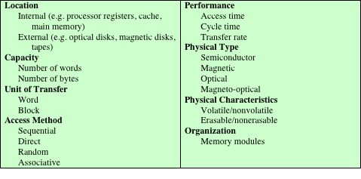
Key Characteristics of Computer Memory Systems
Notes:
The complex subject of computer memory is made more manageable if we classify
memory systems according to their key characteristics. The most important of these
are listed in Table 4.1.

Slide 4
Memory Hierarchy
Design constraints on a computer’s memory can be summed up by three questions:
How much, how fast, how expensive
There is a trade-off among capacity, access time, and cost
Faster access time, greater cost per bit
Greater capacity, smaller cost per bit
Greater capacity, slower access time
The way out of the memory dilemma is not to rely on a single memory component or technology, but to employ a memory hierarchy

Slide 5
Hierarchy List
As one goes down the hierarchy, following occurs:
Decreasing cost per bit,
Increasing capacity,
Increasing access time,
Decreasing frequency of access of the memory by the processor
Registers
L1 Cache
L2 Cache
Main memory
Hard Drive/ Magnetic Disks
Optical
Magnetic Tape

Slide 6
Locality of Reference
Programs tend to reuse data and instructions they have used recently (subroutines and iterations).
Memory references tend to cluster - over a short period of time, the processor is primarily working with fixed clusters of memory references.
An implication of locality is that we can predict with reasonable accuracy what instructions and data a program will use in the near future based on its accesses in the recent past.
Spatial locality
tendency of a processor to involve a number of memory locations that are clustered (addresses are near to one another).
Temporal locality
tendency of a processor to access memory locations that have been used recently.

Slide 7
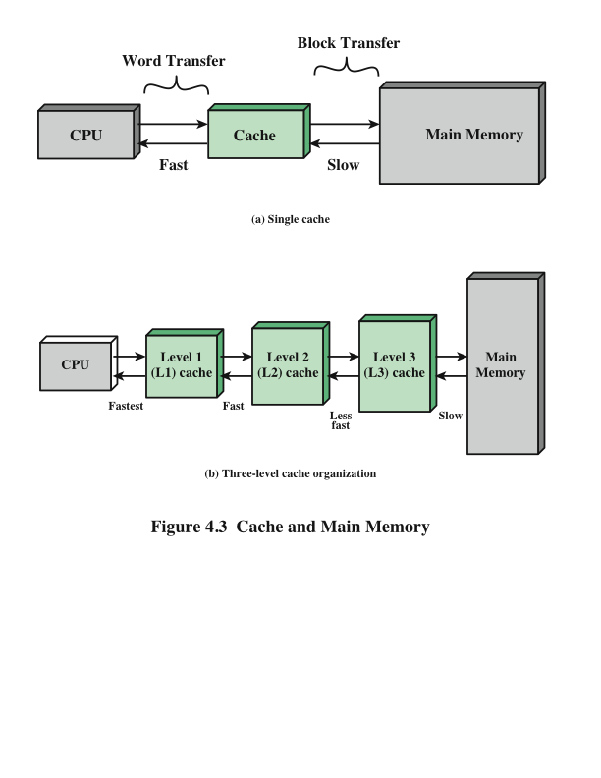
Cache and Main Memory

Slide 8
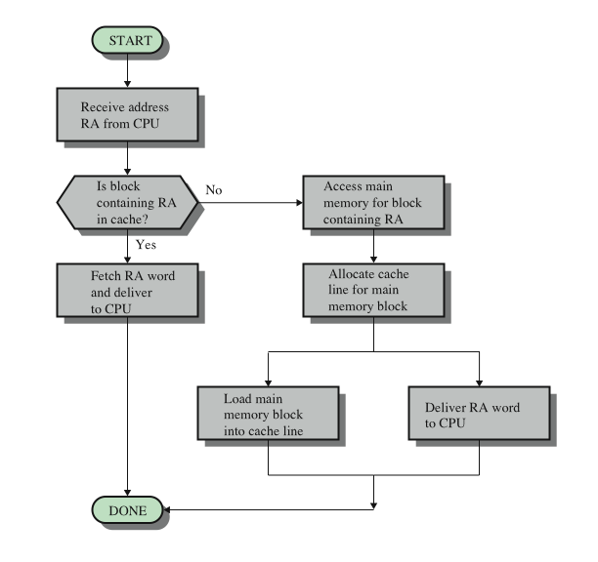
Cache Read Operation

Slide 9
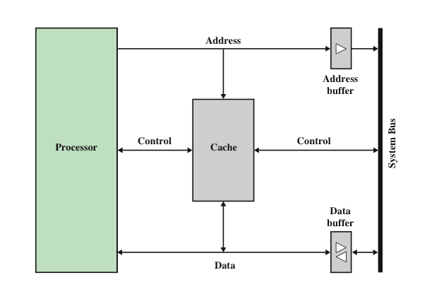
Typical Cache Organization

Slide 10
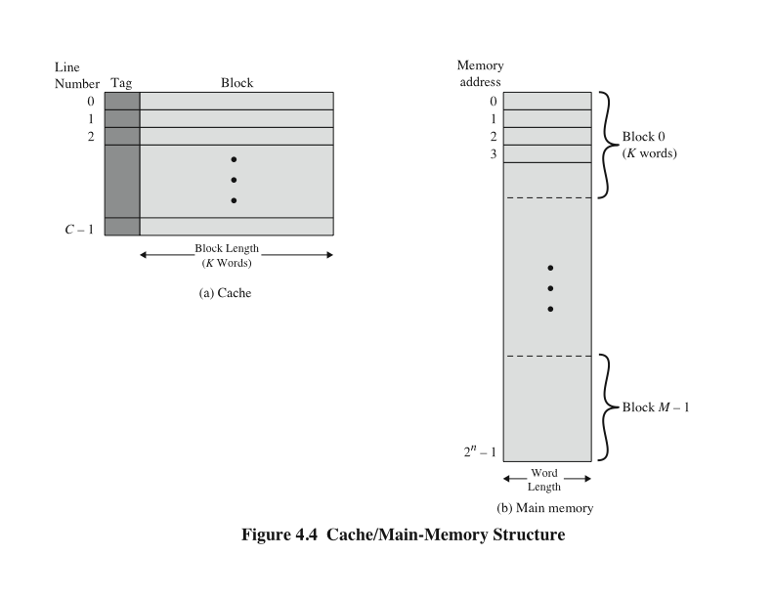
Cache/Main Memory Structure

Slide 11
Elements of Cache Design
Cache Size
Line Size
Number of Caches
Cache Mapping
Replacement Algorithms
Write Policy

Slide 12
Cache Mapping
Direct Mapping
Associative Mapping
Set associative mapping

Slide 13
Internal Memory

Slide 14
Internal Memory
Organization
SRAM DRAM
Types of ROM

Slide 15
External Memory

Slide 16
Magnetic Tape
Magnetic tape was the first kind of secondary memory.
Still Used as low cost, slowest speed member of the memory hierarchy.
Medium is flexible polyester tape coated with magnetizable material.
Data on the tape are structured as a number of parallel tracks running lengthwise
Serial recording (serpentine recording)
Data are laid out as a sequence of bits along each track

Slide 17
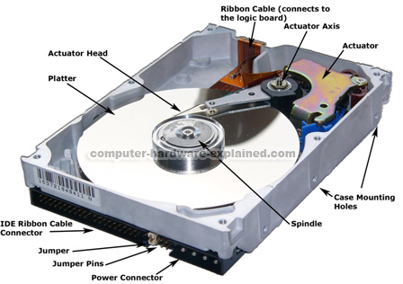
Magnetic Disk
A disk is a circular platter constructed of nonmagnetic material, called the substrate, coated with a magnetizable material
Traditionally the substrate has been an aluminium or aluminium alloy
Recently glass substrates have been introduced

Slide 18
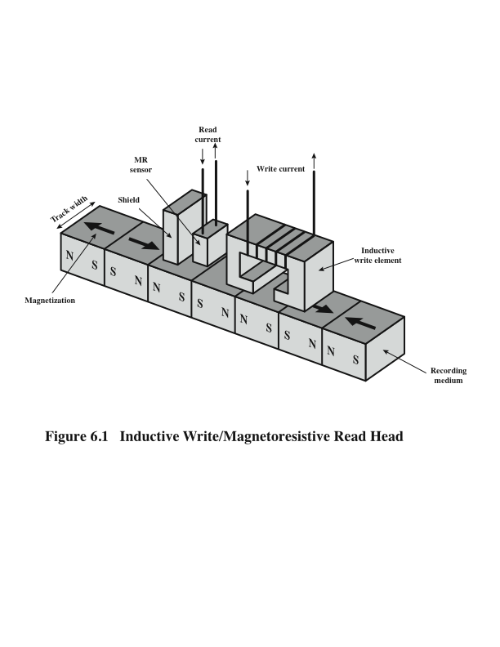

Slide 19
Disk Device Terminology
Arm
Inner
Track
Head
Sector
Outer
Track
Platter
Actuator

Slide 20
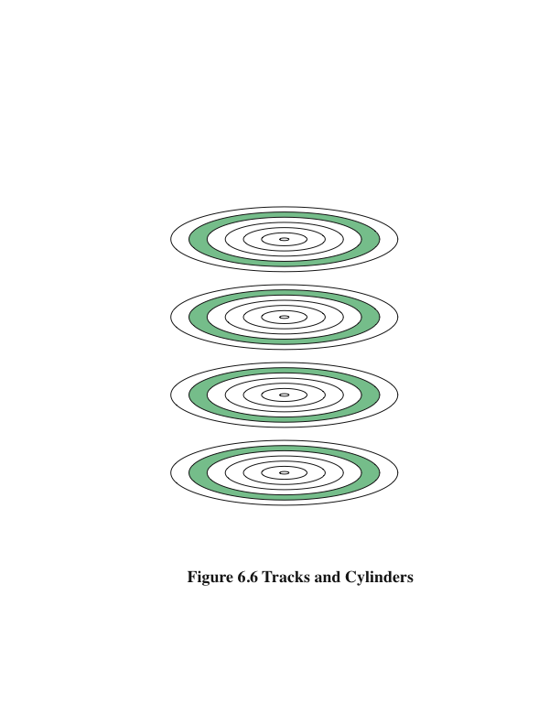
A cylinder is the set of tracks at a given radius of a disk pack. i.e. a cylinder is the set of tracks that can be accessed without moving the disk arm. 
All the information on a cylinder can be accessed without moving the read/write arm.

Slide 21
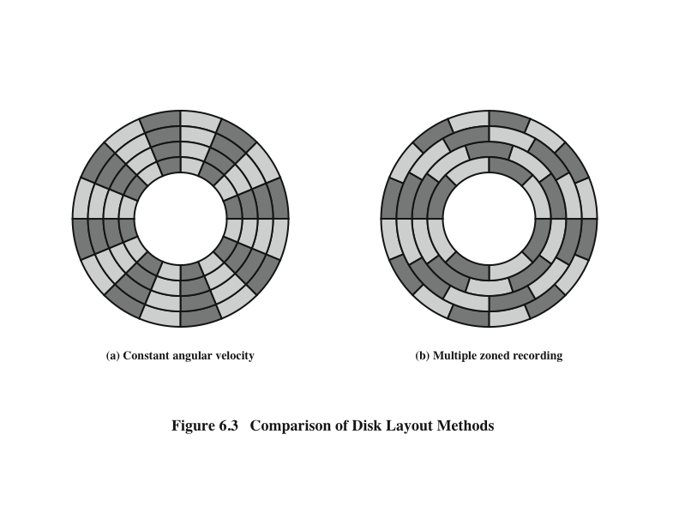
Disk Layout Methods
Disk storage capacity is limited by the maximum recording density that can be achieved on the innermost track.
Zones farther from the centre contains more bits(more sectors) than zones closer to the centre.

Slide 22
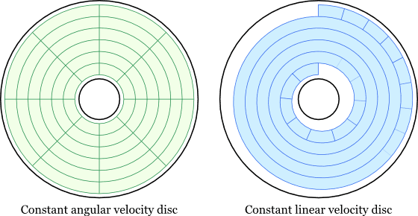

Slide 23
Physical Characteristics of Disk Systems
Head Motion
Fixed head (one per head)
Movable Head (one per surface)
Disk Portability
Non-removable
Removable
Sides
Single Sided
Double Sided
Platters
Single Platter
Multiple Platter
Head Mechanism
Contact (floppy)
Fixed gap

Slide 24
Disk Performance Parameters
When the disk drive is operating the disk is rotating at constant speed.
To read or write the head must be positioned at the desired track and at the beginning of the desired sector on the track
Track selection involves moving the head in a movable-head system or electronically selecting one head on a fixed-head system.
Once the track is selected, the disk controller waits until the appropriate sector rotates to line up with the head.
Seek time
Rotational delay (rotational latency)
Transfer time

Slide 25
Consider a disk with an advertised average seek time of 4 ms, time taken by the head to move from one track to adjacent track is 0.5 ms, rotation speed of 15,000 rpm, and 512-byte sectors with 500 sectors per track. Suppose that we wish to read a file consisting of 2500 sectors for a total of 1.28 Mbytes. Estimate the total time for the transfer.
For sequential organization (file occupies all sectors on adjacent tracks)
For random organization (accesses to the sectors are distributed randomly over the disk)

Slide 26
A distinction is made between physical records and logical records. A logical record is a collection of related data elements treated as a conceptual unit, independent of how or where the information is stored. A physical record is a contiguous area of storage space that is defined by the characteristics of the storage device and operating system. Assume a disk system in which each physical record contains thirty 120-byte logical records. Calculate how much disk space (in sectors, tracks, and surfaces) will be required to store 300,000 logical records if the disk is fixed-sector with 512 bytes/sector, with 96 sectors/track, 110 tracks per surface, and 8 usable surfaces. Ignore any file header record(s) and track indexes, and assume that records cannot span two sectors.

Slide 27
Other External Memory Examples
Optical Memory
CD
DVD
High Definition optical disks
Solid State Drives

Slide 28
Reference
Computer Organization and Architecture: Designing for Performance, William Stallings, 9th Edition, Pearson India, 2013.

